Slide 1


РАФФ
Conditional Denoising Diffusion
for time series

Slide 2
РАФФ
Conditional Denoising Diffusion
for time series

Slide 3

CONTENT
01
PIPELINE
02
MOTIVATION
03
ARCHITECTURE
04
RESULTS
05
METRICS
06
ABOUT US

Slide 4

Motivation
Objective n° 1
Objective n° 2
Objective n° 3
Improvement and testing of forecasting algorithms
Augmentation of data to increase the size of the dataset
Protection of anonymity and confidentiality of data

Slide 5

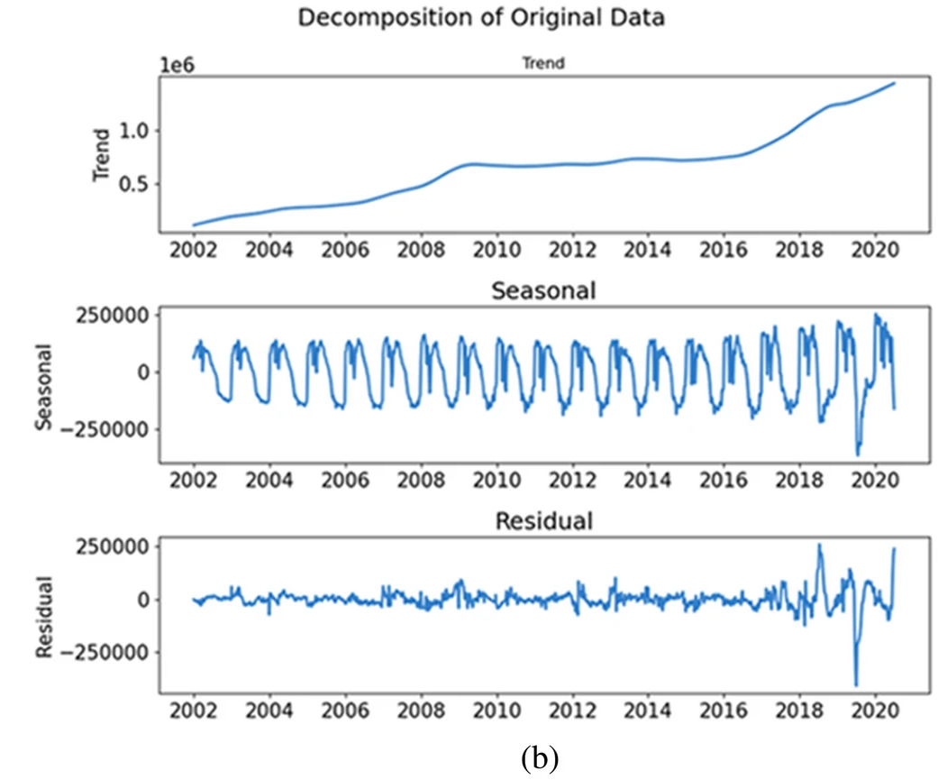

real data
Pipeline
ETS-decomposition
Denoising diffusion
(CNN architecture)
fake data

Slide 6
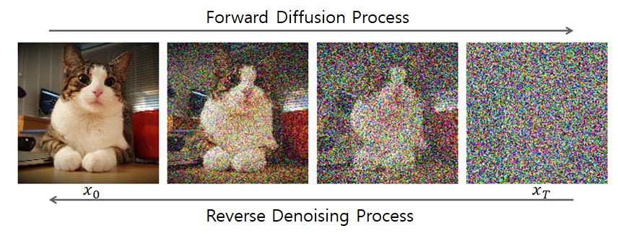
Denoising Diffusion
CNN
conditional data
-Conv1d
-BatchNorm1d
-ReLU
-Dropout

Slide 7
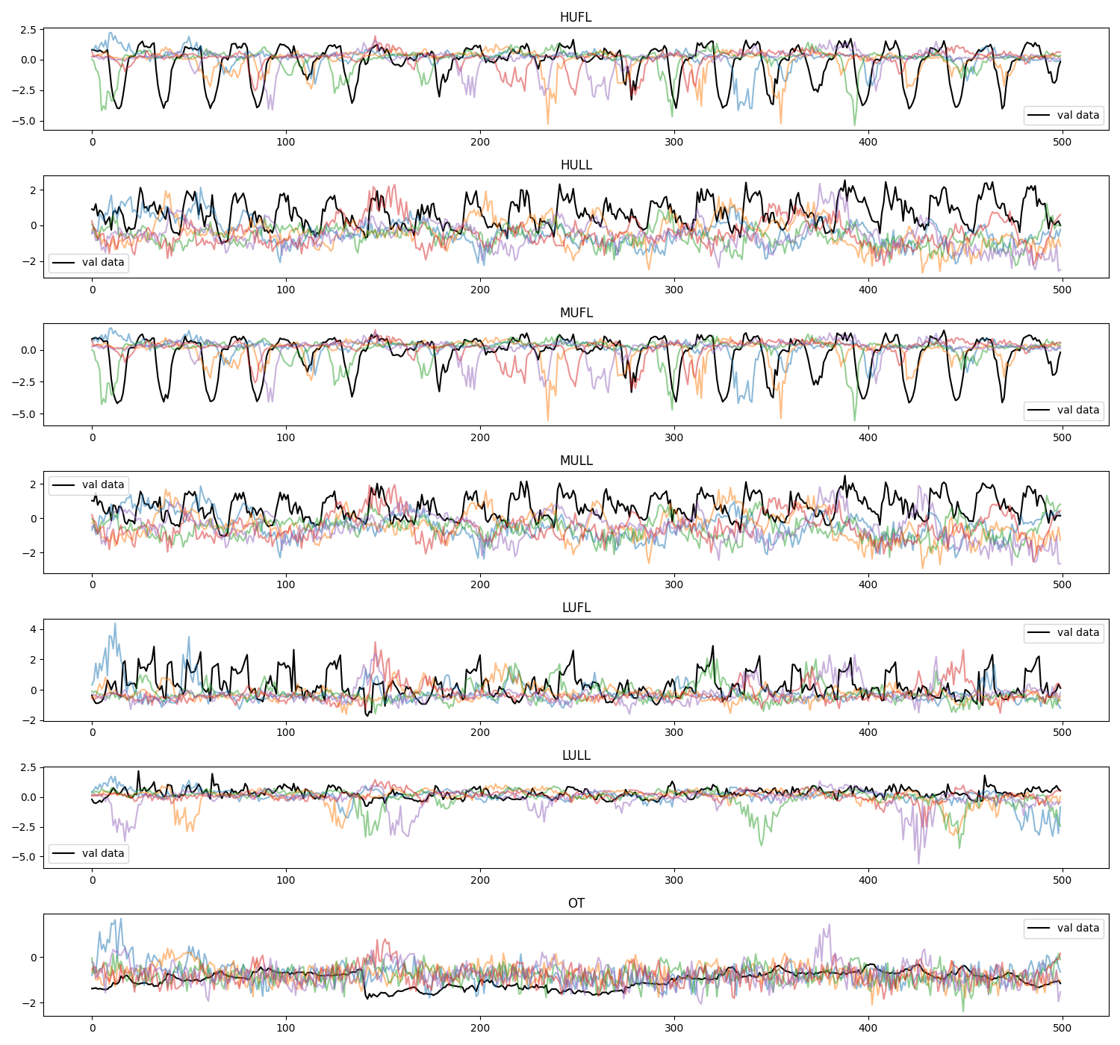
Diffusion results 1/2

Slide 8
Diffusion results 2/2

Slide 9
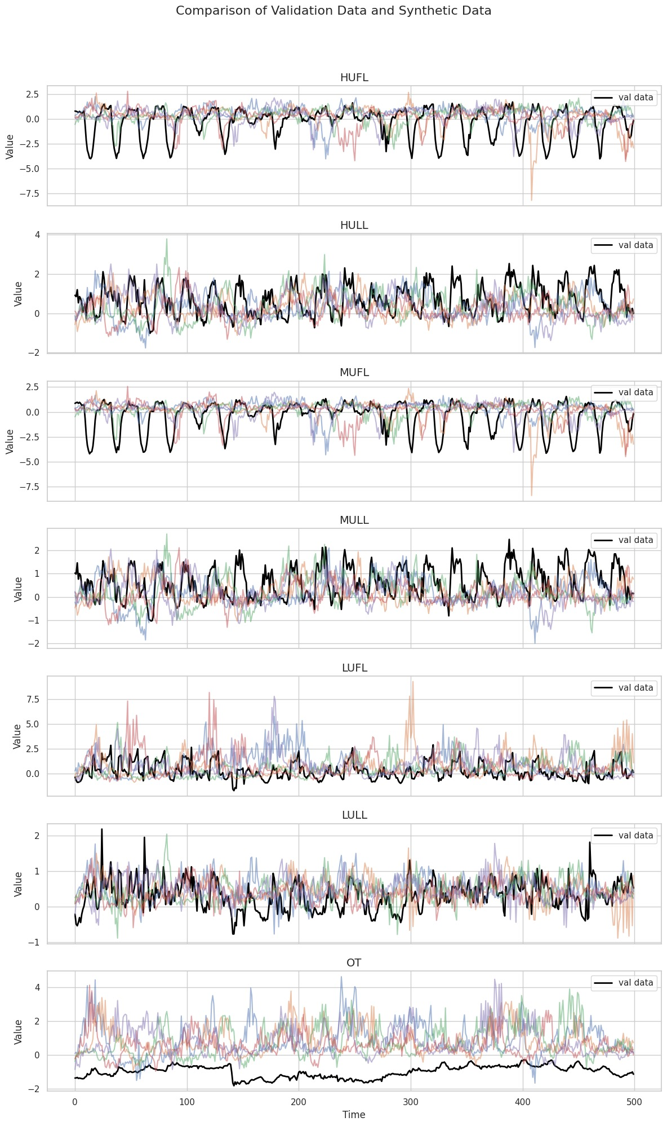
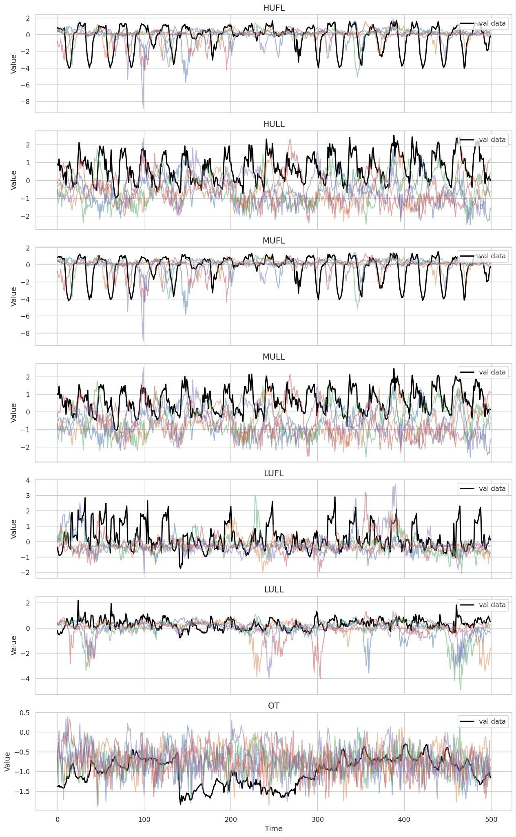
Diffusion+ETS results

Slide 10
Diffusion results 2/2

Slide 11
Diffusion results 1/2

Slide 12
Diffusion+ETS results
DD
DD+ETS

Slide 13
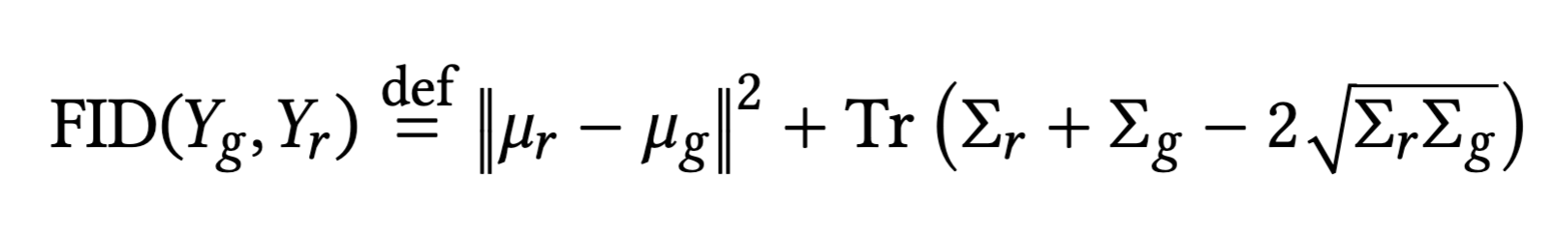

Metrics
CUSTOMERS

Slide 14
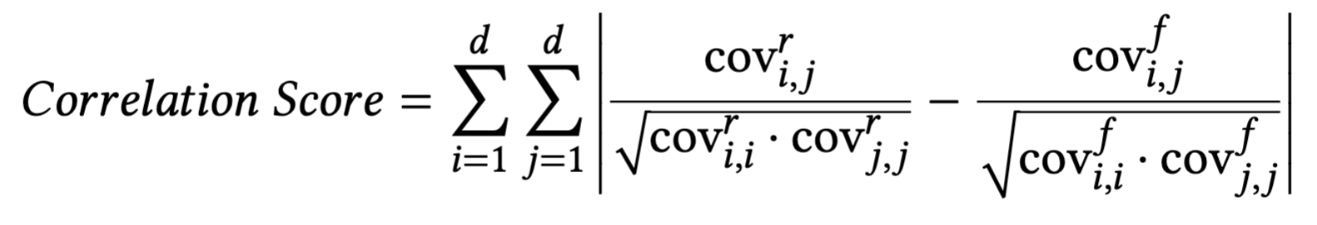
Metrics
CUSTOMERS

Slide 15

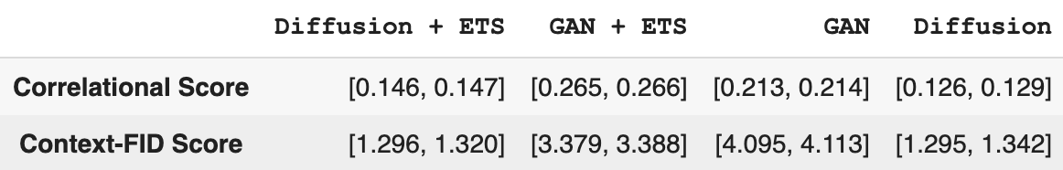
Metrics
CUSTOMERS

Slide 16





OUR TEAM
Рустам
и Леша
Фёдор Жирков
Алина Салимова
Анатолий Попов
РАФФ

Slide 17

THANK'S FOR WATCHING

